Slide 1
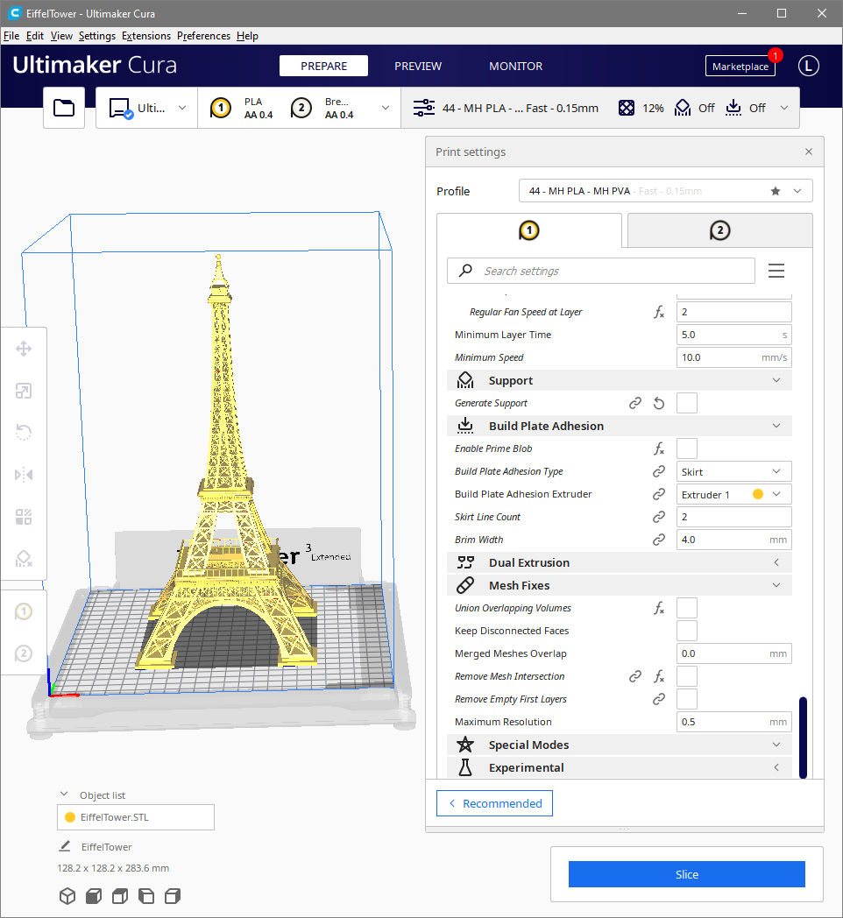
Ultimaker Cura
Profile and User Interface Improvements
Presented by
Lance A. Endres, Ph.D.

Slide 2
Please feel free to interrupt, ask questions, or have me repeat something that is unclear.
Ultimaker Cura Profile Discussion
Notes:
To To bring user-friendly desktop pickTo bring user-friendly desktop pick-and-place technology to the maker community.-and-place technology to the maker community.brTo bring user-friendly desktop pick-and-place technology to the maker community.inTo bring user-friendly desktop pick-and-place technology to the maker community.g user-friendly desktop pick-and-place technology to the maker community.To bring user-friendly desktop pick-and-place technology to the maker community.

Slide 3
Notes:
I’m not trying to claim I have all the answers. My point is, I’m not some internet yahoo popping off about something he has no understanding of. I have a background doing exactly these types of things and I have put significant thought into how I would write the software to solve these problems.

Slide 4
Notes:
I’m not trying to claim I have all the answers. My point is, I’m not some internet yahoo popping off about something he has no understanding of. I have a background doing exactly these types of things and I have put significant thought into how I would write the software to solve these problems.

Slide 5
Problem Statement
Profiles are extremely difficult to work with.
Profiles need to be more “reusable” and flexible.
The user interface is organized poorly.
Notes:
The problem we are trying to solve.

Slide 7
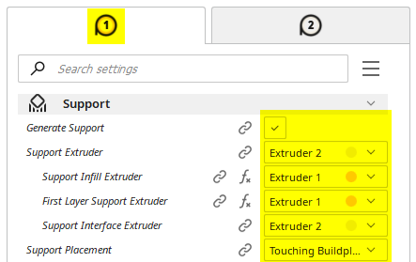
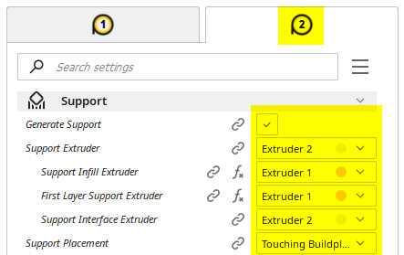
Problems
Duplication of controls on User Interface
2 controls for 1 setting is red flag there is a design issue
Users find it confusing that settings are linked
Non-standard/unique approaches are best avoided

Slide 9
Profile Demonstration Software
A basic example to demonstrate concepts.
A minimum number of settings are incorporated.
Data validation is not complete.
Not intended as “the” solution.
There are many possible valid implementations.
Please focus only on the concepts and learnings.
Take away the Big Picture.

Slide 10
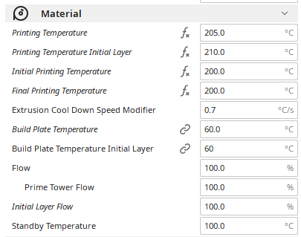
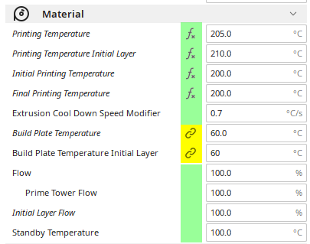
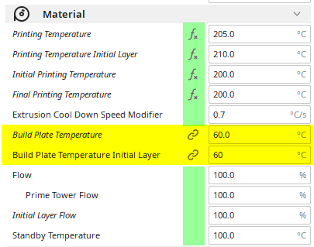
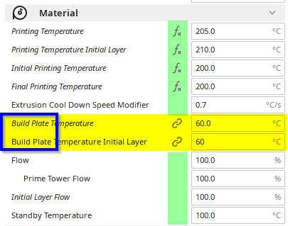
Some Settings Need Moving
Some settings are categorized incorrectly.
They are typically easy to identify.
Categorizing them correctly is typically easy, as well.

Slide 11
Organization Changes
This section contains some specific examples of suggested changes.
Notes:
The problem we are trying to solve.

Slide 12
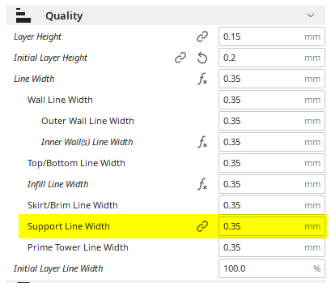
Support Line Width
Support Line Width is the only one of these settings that is “linked” and that is an indication something is wrong.
In this case, the setting is organized in the right place, but its behavior is wrong.
Line widths are more closely associated with nozzle size (extruder).
Each extruder needs its own Support Line Width.

Slide 13
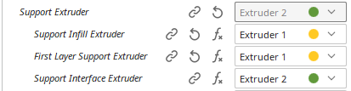
Support Line Width
1
OR
Imagine the case where there is one 0.4 mm nozzle and one 0.8 mm nozzle size loaded.
You have to first select which nozzle is used for support, then go back and set the support line width. This is awkward and unnecessary.
How is case of support interface versus support infill handled? One of the nozzles is going to be printing with the wrong Support Line Width for its size.
2

Slide 14

Mission statement
To bring user-friendly desktop pick-and-place technology to the maker community.
Notes:
To To bring user-friendly desktop pickTo bring user-friendly desktop pick-and-place technology to the maker community.-and-place technology to the maker community.brTo bring user-friendly desktop pick-and-place technology to the maker community.inTo bring user-friendly desktop pick-and-place technology to the maker community.g user-friendly desktop pick-and-place technology to the maker community.To bring user-friendly desktop pick-and-place technology to the maker community.

